Slide 1
The Cart
One Cart for the Entire Internet
Investment Proposal

Slide 2
Problem & Opportunity
Online shoppers face fragmented carts across multiple websites, requiring repeated logins, separate checkouts, and missed savings opportunities. The U.S. e-commerce market exceeds $1 trillion annually, yet no seamless solution exists to unify checkout across most sites.

Slide 3
Our Solution
The Cart is a browser extension and app that lets users collect items from multiple online stores into one universal cart. It streamlines checkout, finds the best prices, applies discount codes automatically, and tracks orders in one place.

Slide 4
How It Works
1. User drags product URLs into The Cart. 2. AI parses product details and price. 3. Extension compiles items from multiple sites. 4. User can checkout site-by-site (MVP) or in one click (full version). 5. Tracks shipping, price changes, and available discounts.

Slide 5
Key Features
- Unified multi-site cart - AI-powered checkout autofill - Real-time price tracking - Automatic discount code search - Order tracking across sites - Optional affiliate/referral integration

Slide 6
Market Size
U.S. e-commerce sales in 2024 exceeded $1 trillion. Target users: 200M+ online shoppers in the U.S. If just 1% adopt The Cart with $5 monthly subscription or affiliate revenue, potential ARR exceeds $120M.

Slide 7
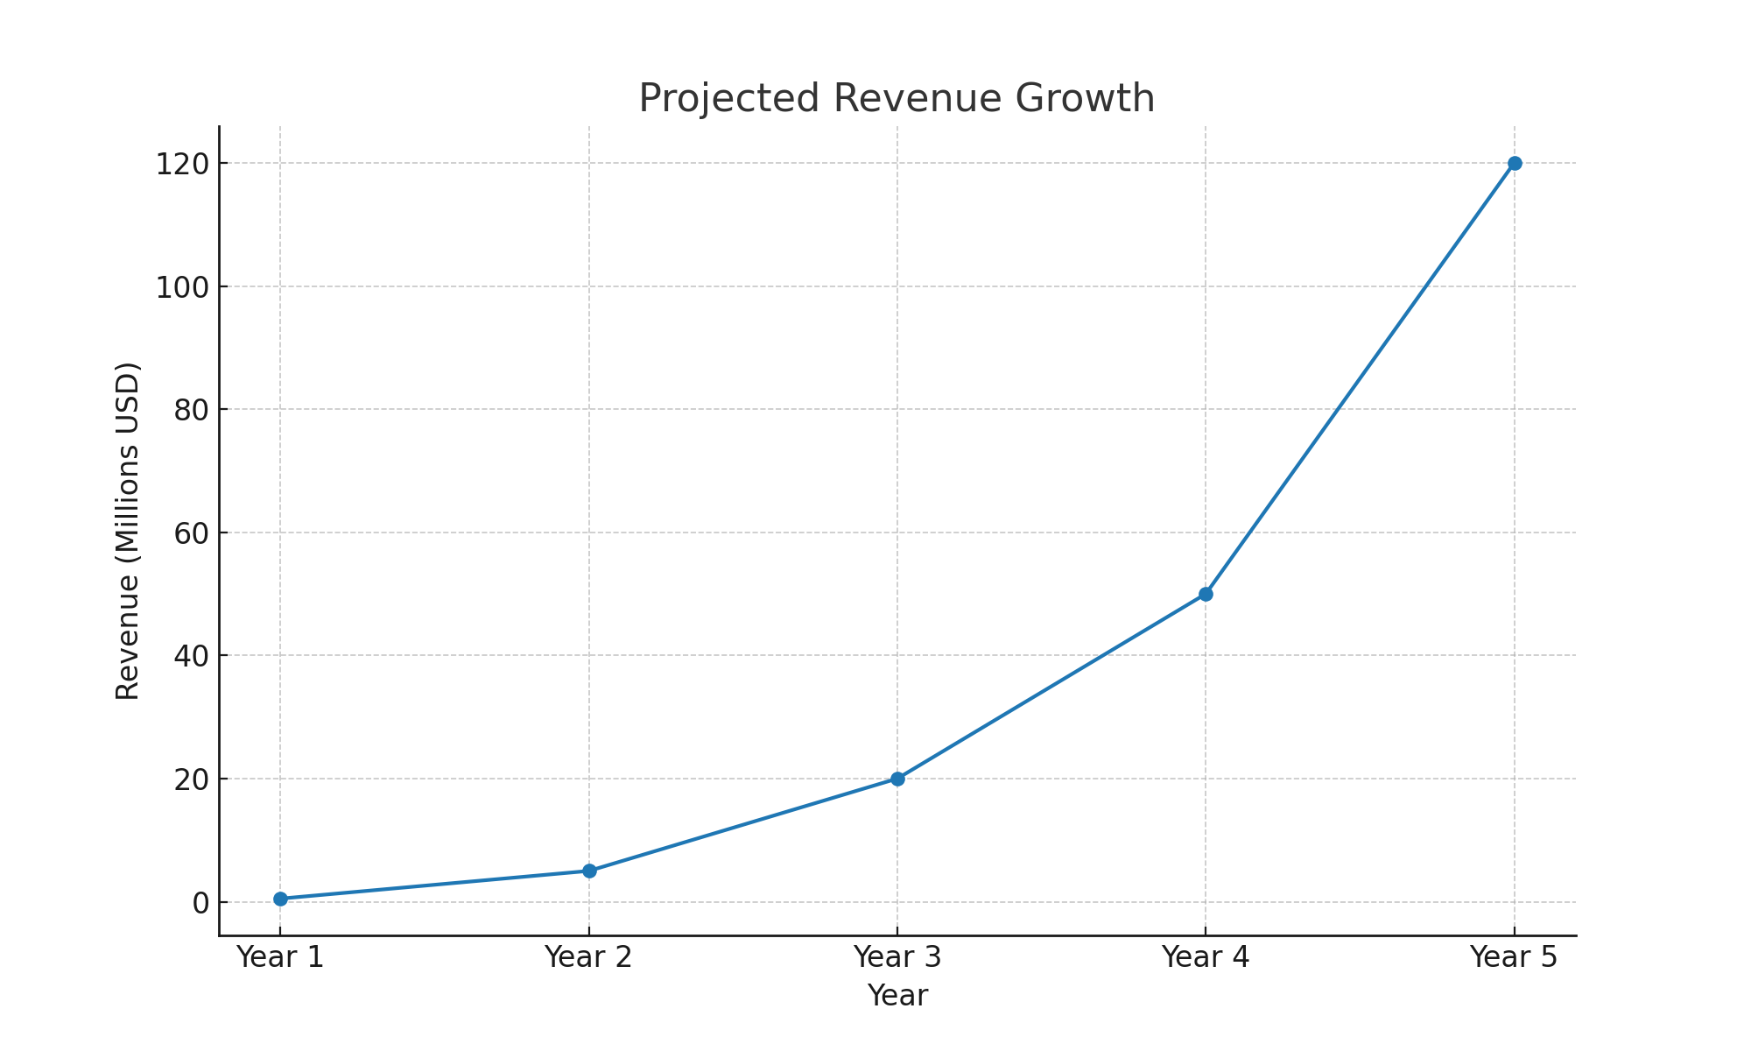
Revenue Model & Projections

Slide 8
Development Timeline & Costs
Phase 1 (4 months, MVP) – Integrate with 3-4 major retailers, site-by-site checkout. Phase 2 (4 additional months) – Expand to 70-80% of e-commerce sites, one-click checkout. Cost: $100K total for full build with 2 full-time developers.

Slide 9
Competitive Advantage
- Works across majority of e-commerce sites - AI-driven checkout automation - Built-in price & order tracking - Minimalistic, user-friendly UI - First-mover advantage in universal cart space

Slide 10
Founder
Jess Kellner – Creator of The Cart Background in production, art direction, and creative project management. Experienced in bringing complex ideas to life with visually engaging execution.

Slide 11
Call to Action
Seeking $100,000 in funding to complete full build. Use of funds: development, design, marketing, and initial scaling. Join us in building the first true cart for the entire internet.

